Slide 1
X Education - Lead Coversion Case Study
By T. Dheeraj Chandra

Slide 2
Background
X Education , An education company named sells online courses to industry professionals.
Many interested professionals land on their website
The company promotes courses on Google. Visitors can browse, fill forms, or watch videos on the website.
Form submissions with email or phone info classify individuals as leads.
After acquiring leads, the sales team contacts them via calls and emails. Some leads convert, but many do not.
The typical lead conversion rate at X education is around 30%

Slide 3
Problem Statement
X Education has many leads but a low conversion rate.
To improve efficiency, they want to identify 'Hot Leads' to focus on, aiming to increase conversions.
We'll assist in selecting promising leads, those with a high likelihood of converting into paying customers.
Our task is to create a model assigning lead scores, ensuring higher scores correlate with a greater chance of conversion.
The CEO aims for a target lead conversion rate of 80%.

Slide 4
Proposed Solution
Selection of Hot Leads
Communicating with Hot Leads
Conversion of Hot Leads
Leads Clustering
We categorize leads based on their probability of converting, enabling us to pinpoint a smaller group of 'hot leads' to prioritize.
Focus Communication
With a reduced number of leads to engage with, our communication efforts can have a greater impact through increased effectiveness.
Increase conversion
By concentrating on hot leads, which are more likely to convert, we anticipate achieving a higher conversion rate, thus allowing us to meet the 80% target.

Slide 5
Proposed Solution
Lead Generation:
1. Ads on websites like Google
2. Referrals
Visit to X Education website by these potential customers (professionals)
Visitors either provide Email id & Contact Details
Or
View videos etc
Tele calling and Emailing activity to all the leads
~30% leads get converted
Proposed Solution:
A model to filter leads so that leads to conversion ratio is 80%+

Slide 6
Proposed Solution
In our problem solution, accurately identifying hot leads is paramount.
The more precise our identification, the greater the likelihood of achieving a higher conversion ratio.
Given our 80% conversion rate target, attaining a high accuracy in identifying hot leads is essential.

Slide 7
Implementation
Loading & Observing the past data provided by the Company
Univariate, Bivariate, and Heatmap for numerical and categorical columns
Performing pre-requisites for RFE and Logistic Regression
Data Gathering
Data Cleaning
Performing EDA
Data Preparation
Model Building
Duplicate removal, null value treatment, unnecessary column elimination, etc.
Outlier Treatment, Feature-Standardization

Slide 8
Implementation
Selection of top 25 features using RFE
Reduction of columns and Model re-building
Verifying our Final Model Accuracy etc. with model built with PCA
Feature Selection
Model Building
Model Improvement
Final Model
Verifying with PCA
Model building using RFE for selected columns
Final Model Analysis and performance on Test Data

Slide 9
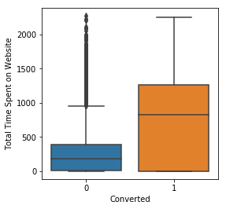
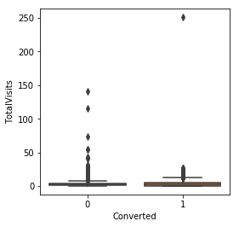
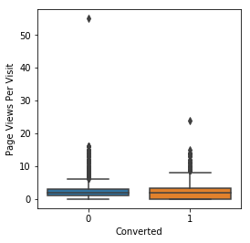
Data Visualization (Plots & Graphs)
EDA plots depicting variation in numerical columns for those who Converted and those who didn't.

Slide 10
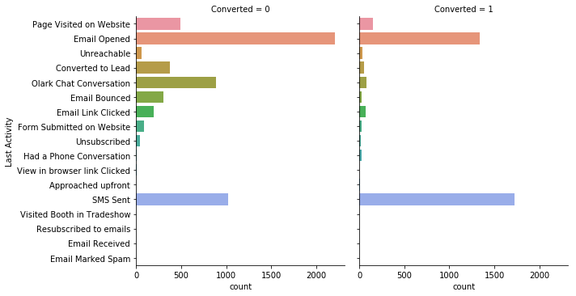
Data Visualization (Plots & Graphs)
EDA plots depicting variation in categorical column
(Last Activity) for those who Converted and those who didn't.

Slide 11
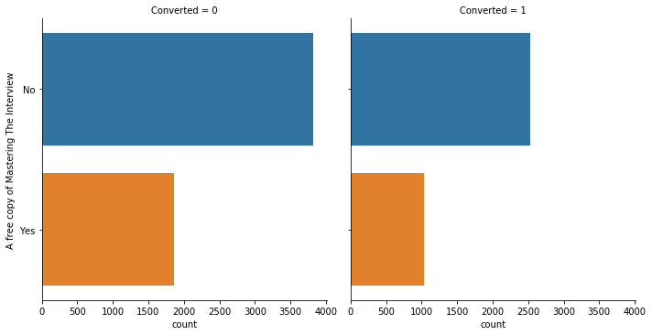
Data Visualization (Plots & Graphs)
EDA plots depicting variation in categorical column (A free copy of Mastering The Interview) for those who Converted and those who didn't.

Slide 12
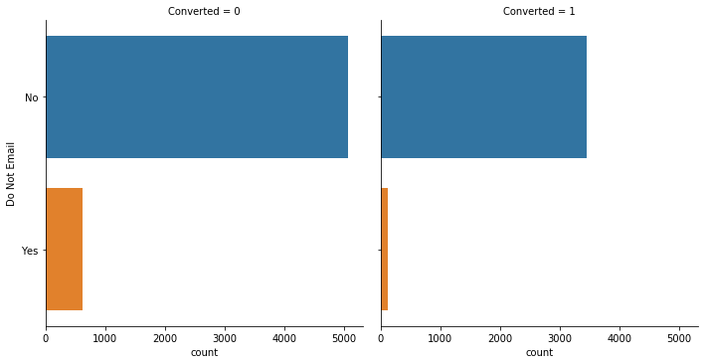
Data Visualization (Plots & Graphs)
EDA plots depicting variation in categorical column
(Do Not Email) for those who Converted and those who didn't.

Slide 13
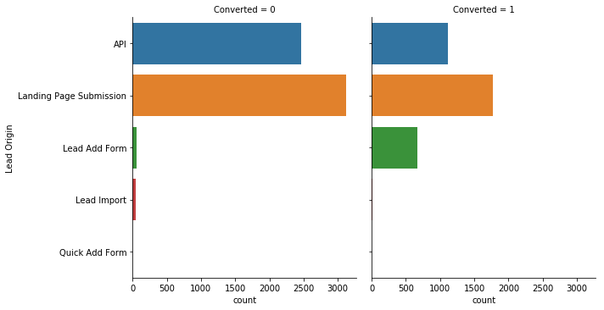
Data Visualization (Plots & Graphs)
EDA plots depicting variation in categorical column (Lead Origin) for those who Converted and those who didn't.

Slide 14
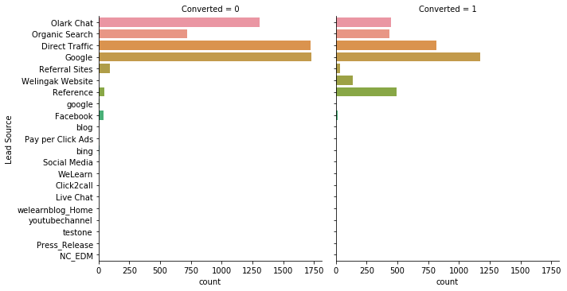
Data Visualization (Plots & Graphs)
EDA plots depicting variation in categorical column
(Lead Source) for those who Converted and those who didn't.

Slide 15
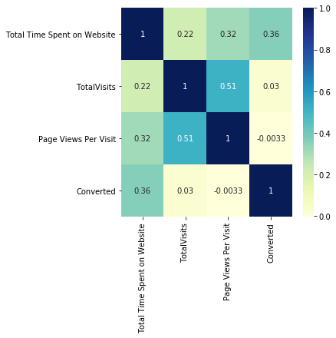
Data Visualization (Plots & Graphs)
EDA plots depicting correlation (Heat Map) of all selected numerical columns.

Slide 16
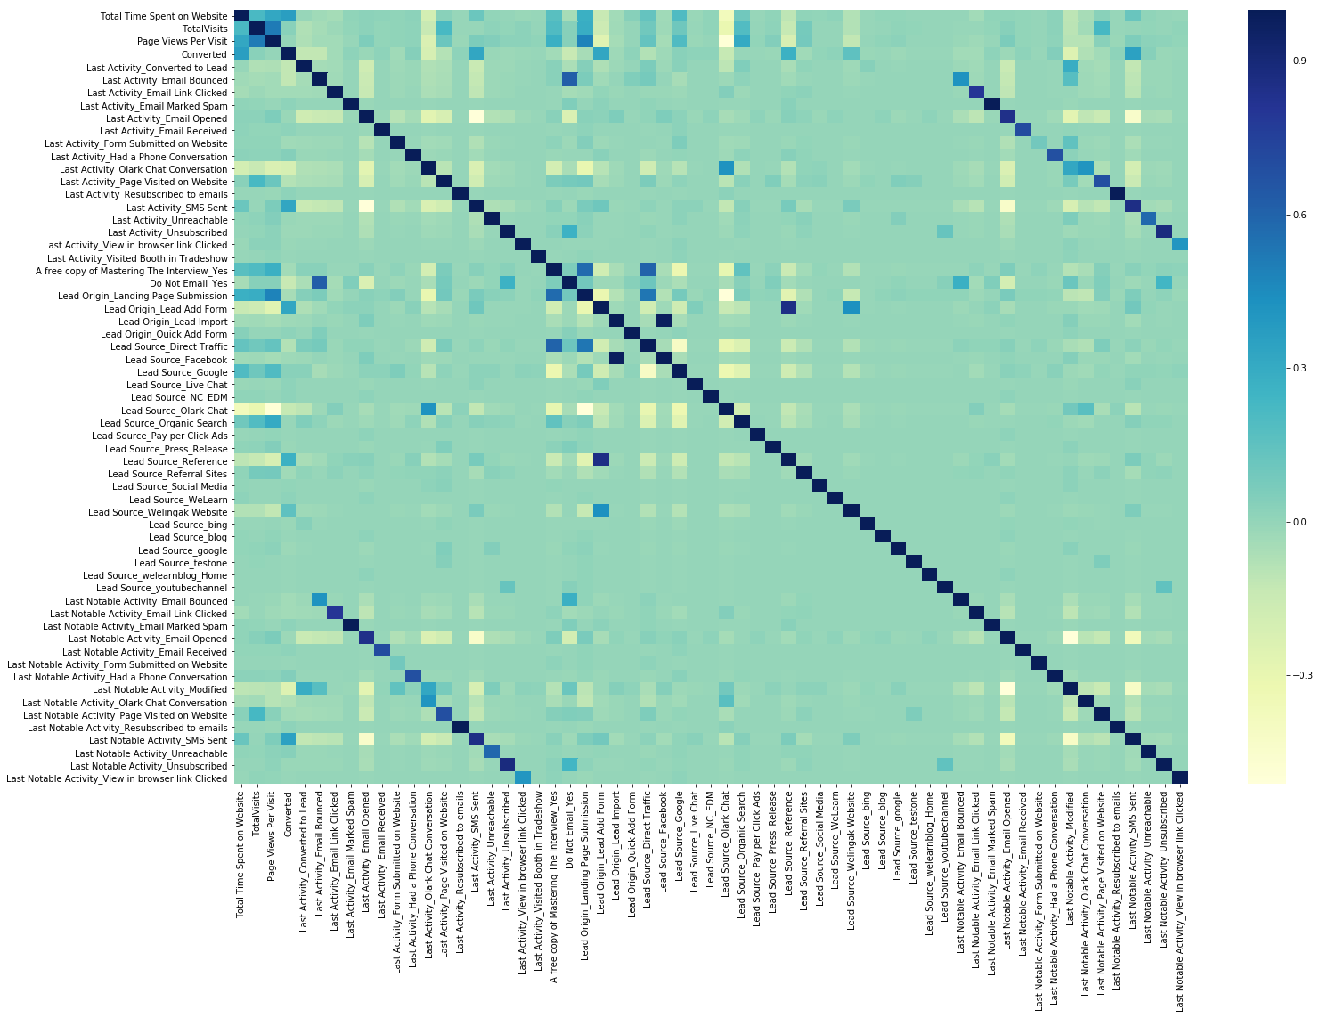
Data Visualization (Plots & Graphs)
EDA plots depicting correlation (Heat Map) of all selected numerical columns.

Slide 17
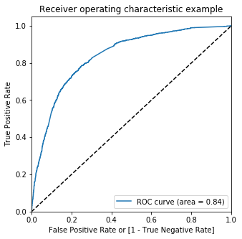
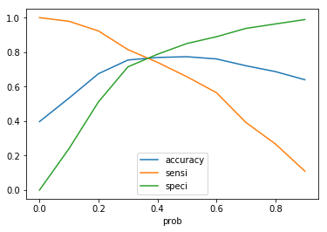
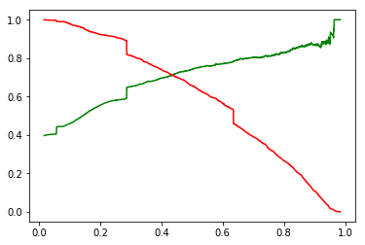
Data Visualization (Plots & Graphs)
Linear Regression Final Model Parameters
Area under ROC = 0.84
Intermediate cut-off = 0.35
Final cut-off = 0.42

Slide 18
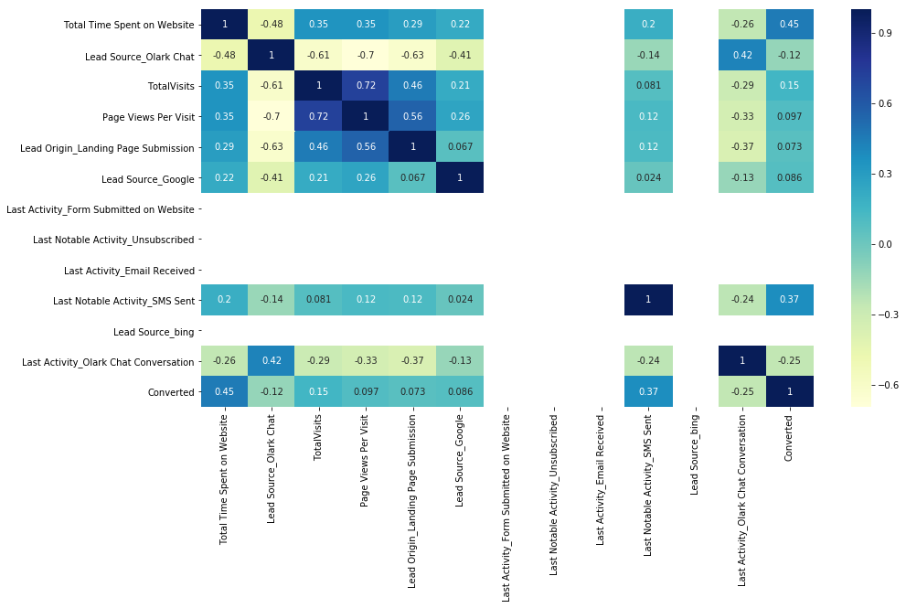
Data Visualization (Plots & Graphs)
EDA plots depicting correlation (Heat Map) of all selected columns (numerical columns and dummy columns) in our final Model.

Slide 19
Model Analysis
Performance of The Final Model
Overall accuracy on Test set: 0.786
Sensitivity of logistic regression model: 0.733
Specificity of logistic regression model: 0.823

Slide 20
Model Analysis
Business Insights Derived from our Model
Top 3 variables in model, that contribute towards lead conversion are:
Total Time Spent on Website
Last Notable Activity_SMS Sent
TotalVisits

Slide 21
Model Analysis
Business Insights Derived from our Model
Top 3 variables in my model, that should be focused are:
Last Activity_SMS Sent (positively impacting)
Last Activity_Olark Chat Conversation (negatively impacting)
Lead Source_Olark Chat (negatively impacting)

Slide 22
Conclusion 1 (LR Model)
The Logistic Regression Model performs adequately well compared to the PCA-derived model, achieving an accuracy of 78.6% on the test set.
It demonstrates a sensitivity of 73.3% and specificity of 82.3%.
By adjusting the cut-off value, we can fine-tune these parameters, allowing us to predict hot leads based on different scenarios, such as resource availability, and vice versa.

Slide 23
Conclusion 2 (Recommendation)
The X Education Company should prioritize several key aspects to enhance its overall conversion rate:
Enhance user engagement on the website, as it correlates with higher conversion rates.
Amplify the frequency of sending SMS notifications, as they contribute to increased conversions.
Boost total website visits through targeted advertising campaigns and other means, as it positively impacts conversion rates.
Focus on improving the Olark Chat service, as its current performance is negatively affecting conversion rates.

Slide 24
THANK YOU

